Slide 1
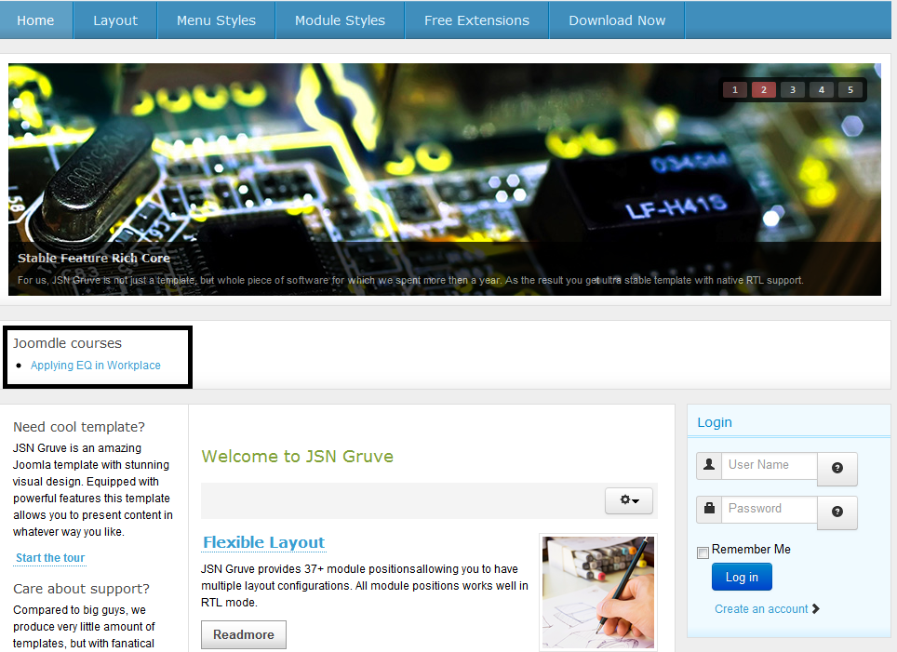
Notes:
My Main Page

Slide 2
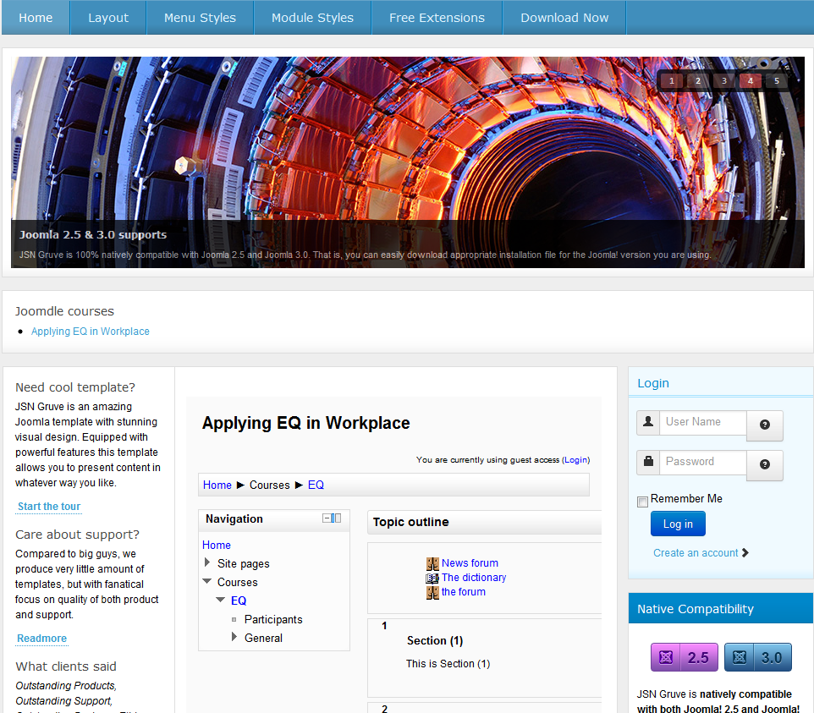
Notes:
When course link is clicked, it insert the course in the middle section, but the view zone of the section is too small.

Slide 3
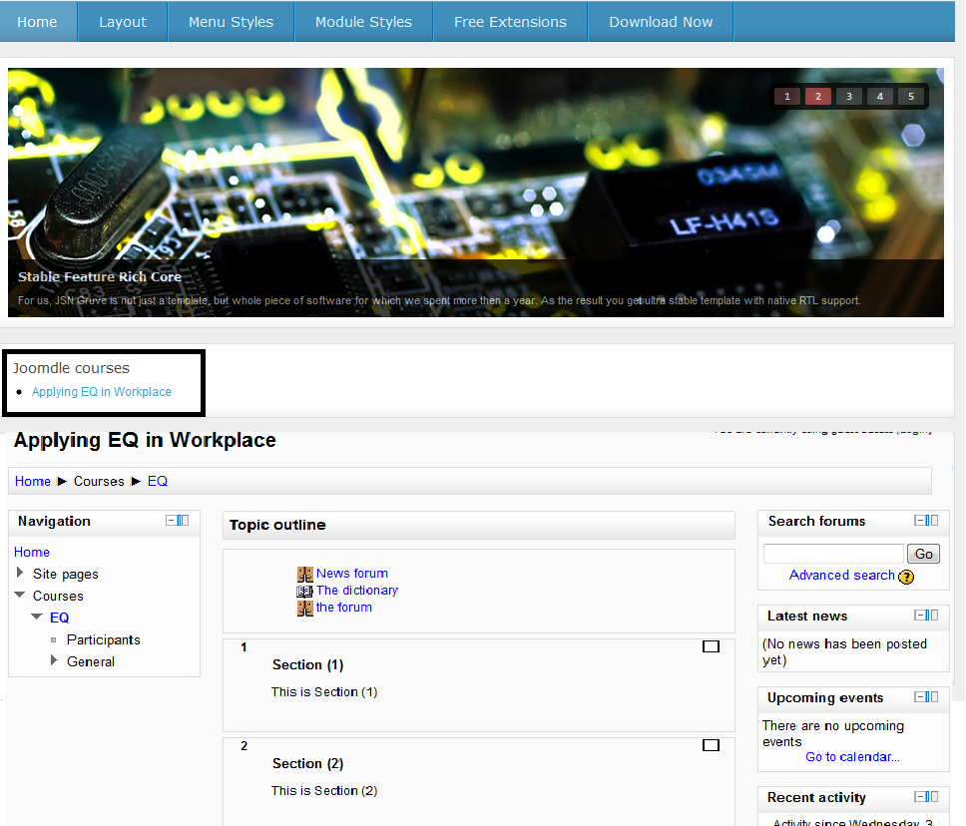
Notes:
What I want is something like this.

